Slide 1

Hypertension in pregnancy
Dr.Carmeline motha
Consultant Physician & Senior Lecturer
Department of Obstetrics & Gynaecology
Faculty of Medicine, Ragama

Slide 2
Classification
Chronic hypertension
Gestational hypertension
Pre-eclampsia
Severe pre-eclampsia
Eclampsia

Slide 3
Chronic hypertension
Pre conception counselling
Review drugs-ACEI/ARB
Antenatal care
Aim for BP<150/100 mmHg
If TOD aim for BP<140/90 mmHg (Keep DBP>80 mmHg)
If secondary cause- refer for specialist care

Slide 4
GESTATIONAL HYPERTENSION

Slide 5

What is high BP in pregnancy?
Mild
Diastolic BP 90-99mmHg or systolic BP 140-149mmHg
Moderate
Diastolic BP 100-109mmHg or systolic BP 150-159mmHg
Severe
Diastolic BP ≥ 110mmHg or systolic BP ≥ 160 mmHg

Slide 6

How to measure blood pressure?
Seated/semi reclined
Avoid supine- turn to left lateral position

Slide 7
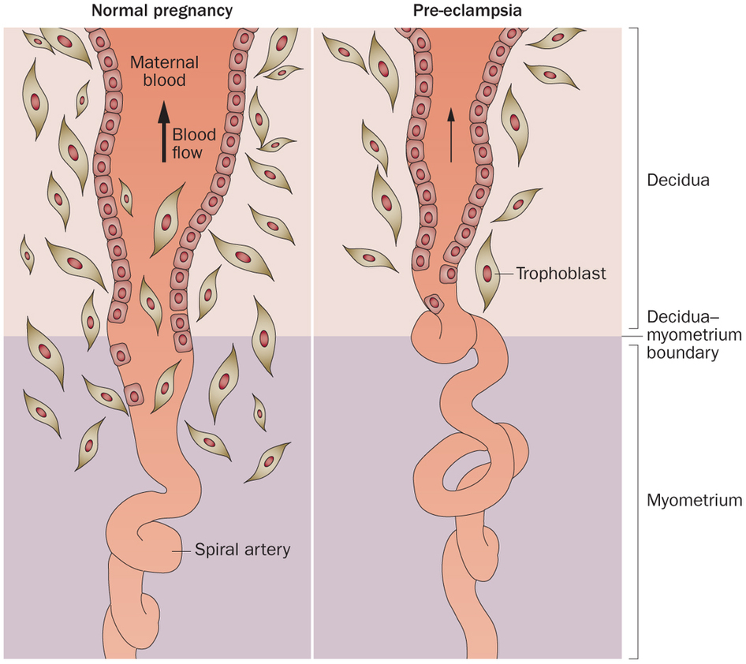
Aetiology of gestational hypertension

Slide 8
Mild hypertension
No need for admission
No need for treatment
Measure BP and proteinuria weekly
- If presenting <32 weeks/high risk of pre-eclampsia-measure proteinuria and BP twice weekly

Slide 9
Moderate hypertension
No need for admission
Treatment to maintain BP< 150/100 mmHg
Measure BP and proteinuria twice weekly
Test kidney functions, electrolytes, FBC, liver transaminase and bilirubin

Slide 10

Severe HT
Admit to hospital
Treatment to maintain< 150/100 mmHg
Measure BP at least four times a day
Test for proteinuria daily
Test kidney functions, electrolytes, full blood count, transaminase and bilirubin at presentation and then weekly.

Slide 11
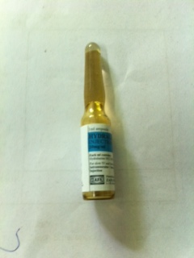

Medications in hypertension of pregnancy
Anti HT (Antenatally)
Labetolol (if high iv)
Methyldopa
Nifedipine
Hydralazine (if high iv)

Slide 12

Timing of birth-gestational HT
Mild/moderate HT- Do not offer birth <37 weeks
After 37 weeks timing according to maternal and fetal indications

Slide 13
Intrapartum care
Mild/moderate hypertension
Measure BP hourly
Continue antenatal HT treatment
Severe hypertension
Measure BP continually
Continue antenatal HT treatment
If BP within normal range do not limit 2nd stage of labour

Slide 14
Post natal care
Gestational hypertension
Stop antihypertensives
Start anti HT if BP ≥ 150/100 mmHg
Once BP< 140/90 mmHg, consider reducing antiHT treatment
Measure BP
Daily for first two days after birth
At least once 3-5 days after birth

Slide 15
Drugs in hypertensive disorders
No known adverse effects on babies receiving breast milk
Labetolol,methyldopa,nifedipine, enalapril,captopril,atenolol,metoprolol- SAFE
but methyldopa should avoid in postpartum because it can cause depression

Slide 16
Follow up care
Discharge with a plan
Who will provide care
Frequency of BP monitoring –if on treatment needs review 2 weeks after discharge
Thresholds for reducing/stopping treatment
Offer medical review at 6-8 weeks postpartum
If needing anti HT >6-8 weeks needs specialist assessment

Slide 17
Pre-eclampsia

Slide 18
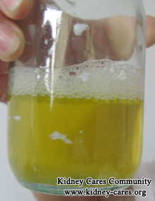
Preeclampsia- definition
Hypertension
Significant proteinuria
> 300mg of proteinuria in a 24 hour urinary collection
With or without ankle oedema

Slide 19
Pre-eclampsia
Mild HT
Do not treat HT
Measure BP at least 4 times a day
Test kidney functions, electrolytes,FBC, transaminase and bilirubin twice a week

Slide 20
Pre-eclampsia
Moderate/severe HT
Treat HT
Measure BP at least 4 times a day
Test kidney functions, electrolytes, FBC, transaminase and bilirubin three times a week

Slide 21
Post natal care
Measure BP closely
Measure platelet, transaminase and creatinine 2-3 days after birth
If BP <150/100mmHg community care

Slide 22
Post natal care
Follow up plan
Measure BP every 1-2 days for 2 weeks until antiHT treatment stopped
Offer medical review at 2 weeks

Slide 23
Severe pre-eclampsia

Slide 24
Severe pre-eclampsia
Definition
Severe HT and proteinuria
Or

Slide 25
Severe pre-eclampsia
2. Mild/moderate HT with proteinuria with at least 1 of
Symptoms-severe headache, visual blurring/flashing/ right hypochondrial pain or vomiting
Signs-papilloedema, clonus, liver tenderness
Inves-HELLP, plt ct <100,000, ALT/AST>70 iu/l)

Slide 26
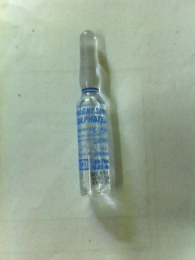
Magnesium sulphate
Indications
Severe HT/ severe pre-eclampsia with an eclamptic fit
Consider giving if birth planned within 24 hrs in a woman with severe pre-eclampsia
Loading dose of 4 g IV over 5 min, followed by 1g/hr infusion over 24 hours

Slide 27
Intrapartum care
Do not preload with IV fliuds before epidural/spinal analgesia
Limit maintenance fluids to 80 ml/hr

Slide 28
Long term health risks
Women who had gestational hypertension risk of developing
Gestational hypertension in a future pregnancy ranges from about 1 in 6 (16%) - 1 in 2 (47%) pregnancies.
Pre-eclampsia in a future pregnancy ranges from 1 in 50 (2%) - 1 in 14 (7%) pregnancies.

Slide 29
Long term health risks
Women who had pre-eclampsia the risk of
gestational hypertension in a future pregnancy ranges from about 1 in 8 (13%) - 1 in 2 (53%) pregnancies.
pre-eclampsia in a future pregnancy ranges from 1 in 6(16%)

Slide 30
Long term health risks
If pregnancy was complicated by severe pre-eclampsia, HELLP syndrome or eclampsia,the risk of pre-eclampsia is
1 in 4 (25%) if delivery <34 weeks
1 in 2 (55%) if delivery <28 weeks

Slide 31

Long term health risks
Advise women who have had pre-eclampsia to achieve and keep a BMI within the healthy range before their next pregnancy (18.5–22.9 kg/m2)

Slide 32
BEST OF LUCK

